Slide 1
OOPS CONCEPTS ENCAPSULATION

Slide 2

OVERVIEW: 1. Real Time Examples 2. What is Encapsulation? 3. Steps 4. Sample Code 5. Benefits

Slide 3
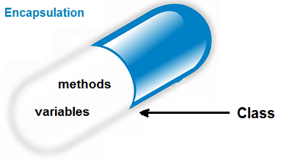

Real Time Examples
Main medicine enclosed in a capsule.
Engine, breaking and gear system etc., are hided from driver.

Slide 4
WHAT IS ENCAPSULATION???
Encapsulation in Java is a mechanism of wrapping the data (variables) and code acting on the data (methods) together as a single unit.

Slide 5
Steps to achieve Encapsulation:
Declare the variables of a class as private.
Provide public setter and getter methods to modify and view the variables values.

Slide 6
Sample Code:
class Employee
{
private int emp_id;
public void setEmpId(int emp_id1)
{
emp_id = emp_id1;
}
public int getEmpId()
{
return emp_id;
}
}

Slide 7
class Employee
{
private int empid;
public void setEmpId(int eid)
{
empid = eid;
}
public int getEmpId()
{
return empid;
}
}
class Company
{
public static void main(String args[])
{
Employee e = new Employee();
e.setEmpid(101);
System.out.println(e.getEmpid());
}
}

Slide 8
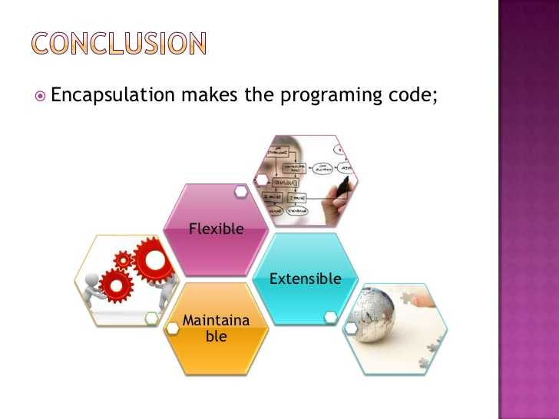
Benefits of Encapsulation

Slide 9
THANK YOU

